Slide 1

Software Engineering
WS-2020-2021
21. Oct
28. Oct
Lesson Mo. 14.15-17.45 h Lab: Mo. 17.45-19.00 h
Room 8-103
04.Nov
11.Nov
18.Nov
25.Nov
02.Dec
09.Dec
16.Dec
13.Jan
20.Jan
27.Jan
03.Feb
10.Feb
https://www.linkedin.com/groups/8689804/

Slide 2


Hierarchical Temporal Memory
Damir Dobric
Microsoft PTSP (Partner Technical Solution Specialist) Microsoft Most Valuable Professional
Blog
Twitter
damir.dobric@daenet.com b-dadobr@microsoft.com

Slide 3
AI / ML
Where we are

Slide 4
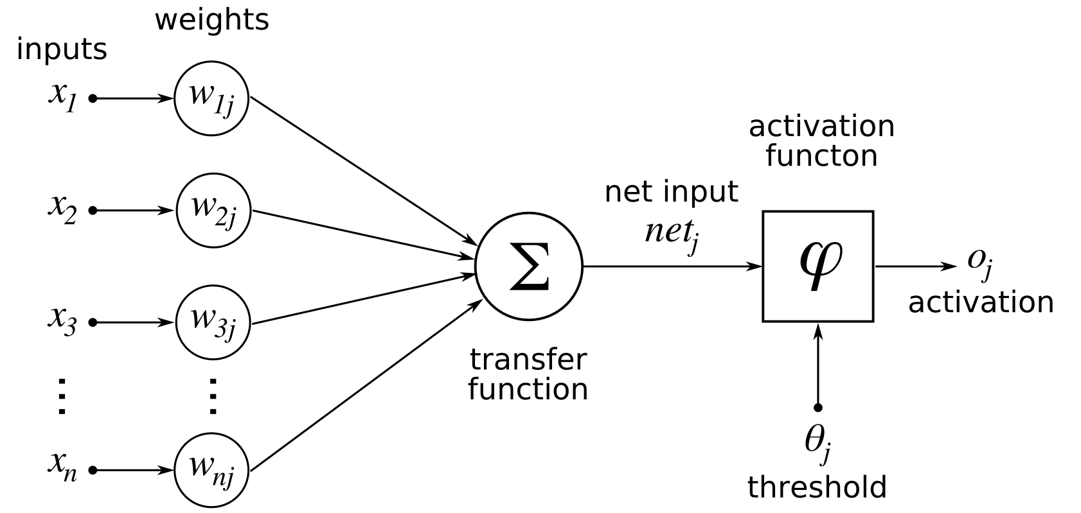
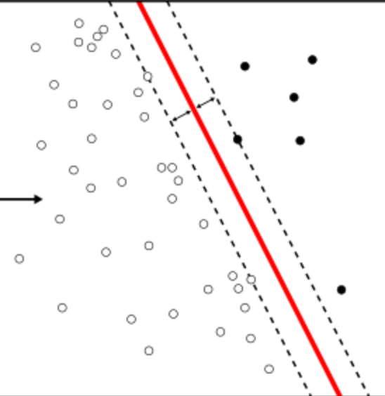
Perceptron
e = xW.

Slide 5
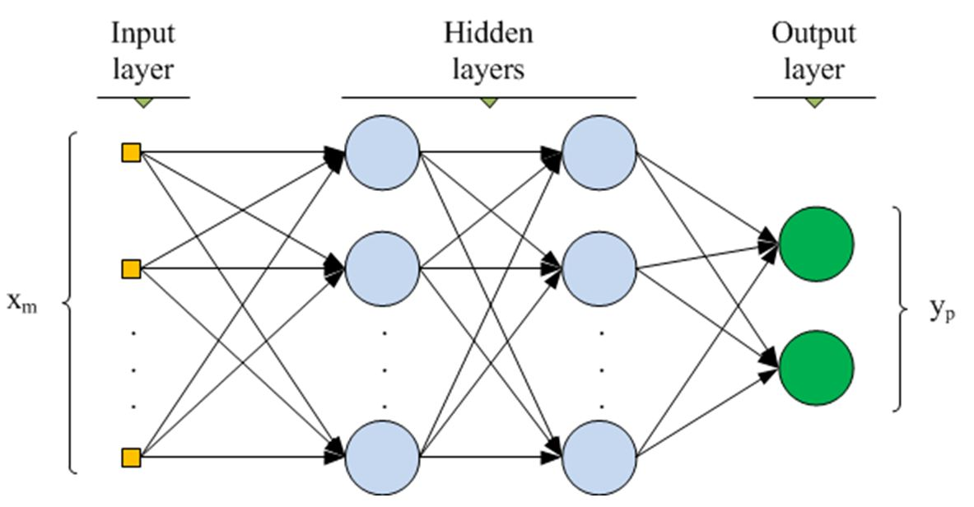
Multilayer ANN
www.cs.us.es/~fsancho/?e=135

Slide 6
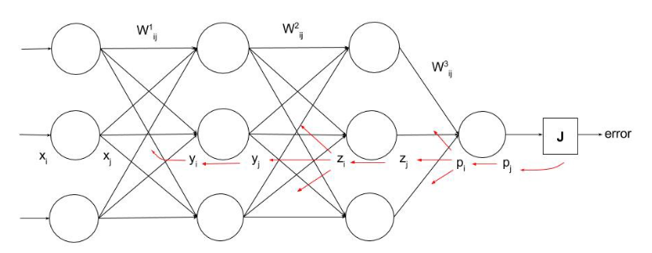
Backpropagation
https://ayearofai.com/rohan-lenny-1-neural-networks-the-backpropagation-algorithm-explained-abf4609d4f9d

Slide 7
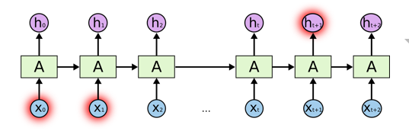
RNN
colah.github.io/posts/2015-08-Understanding-LSTMs

Slide 8
NEOCORTEX
Learning from brain

Slide 9

Brain
Neocortex
(rational)
Limbic
(emotional)
Reptilian
(instinctual)
http://siimland.com/what-to-feed-your-neocortex-to-boost-brain-power/
https://www.shutterstock.com/video/clip-540940-stock-footage--d-render-xray-style-image-of-the-human-brain-hd.html

Slide 10

Neuron

Slide 11
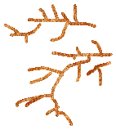
Neuron

Slide 12
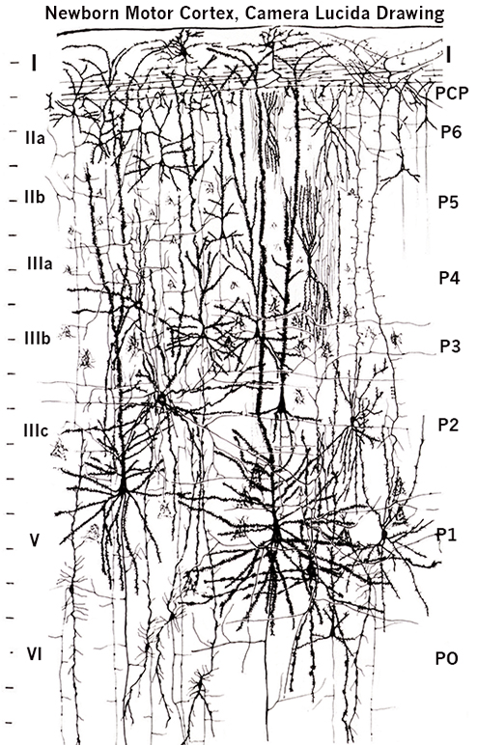
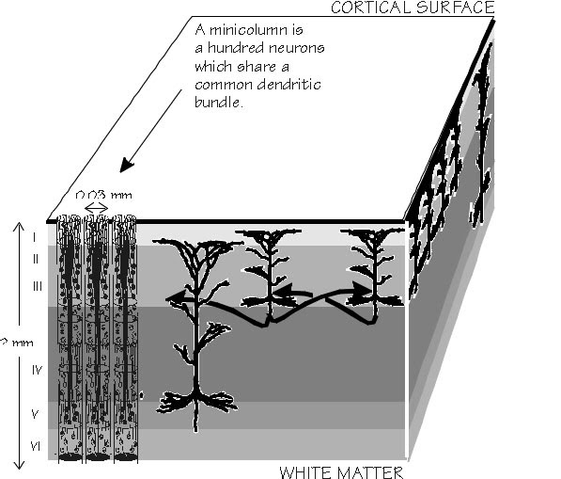
Layers and columns in neocortex
by Santiago Ramón y Cajal (1852-1934)
https://academic.oup.com/brain/article/125/5/935/328135

Slide 13
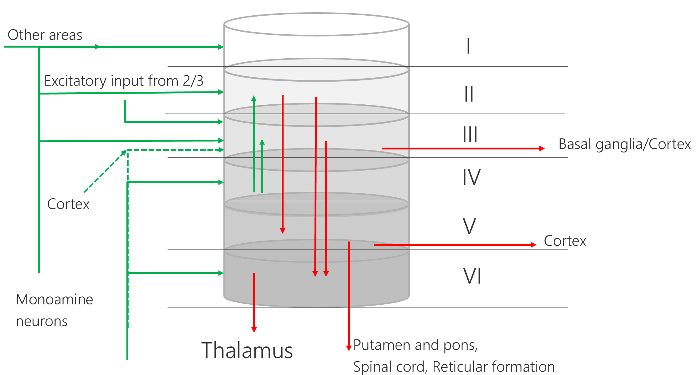
Model of a cortical column

Slide 14
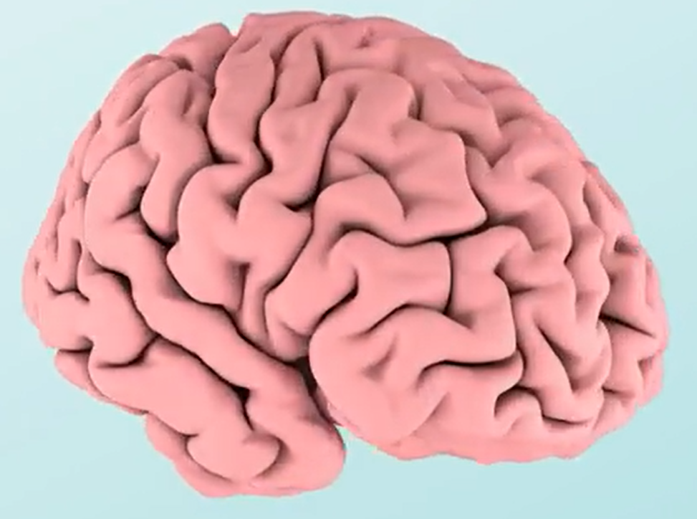

Layers and columns in neocortex

Slide 15
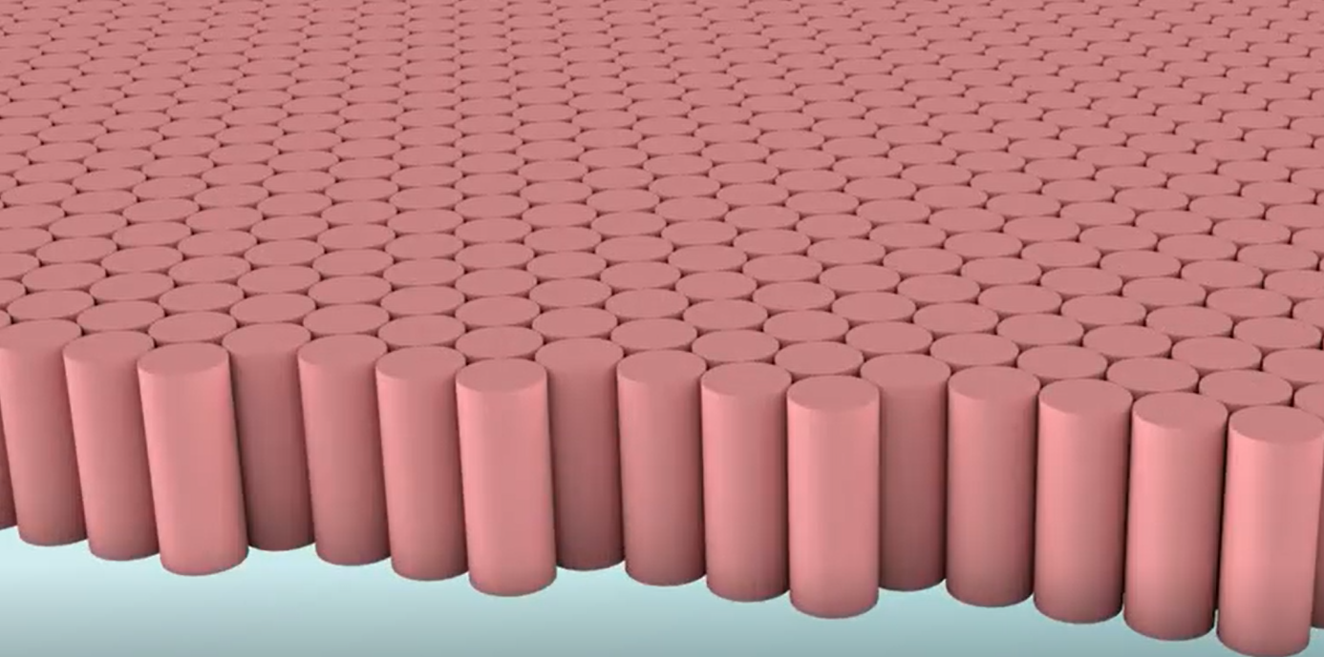
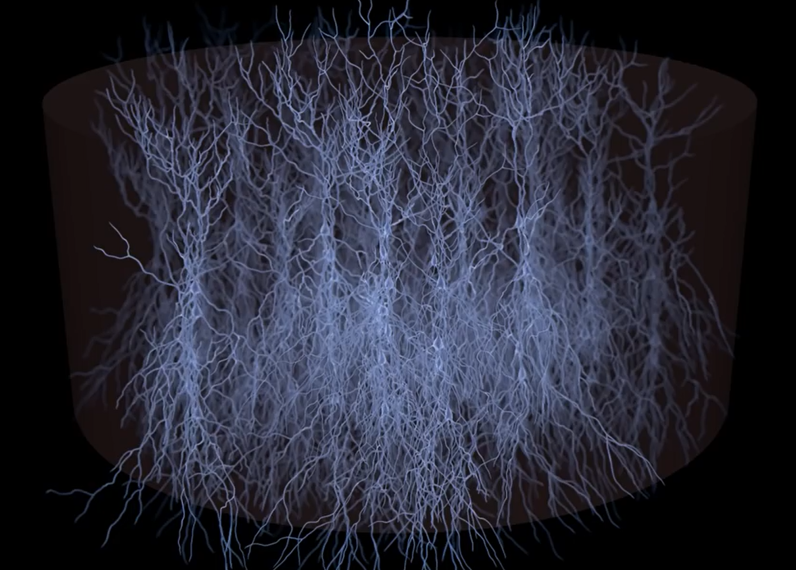
Cortical column with mini-columns
Video

Slide 16
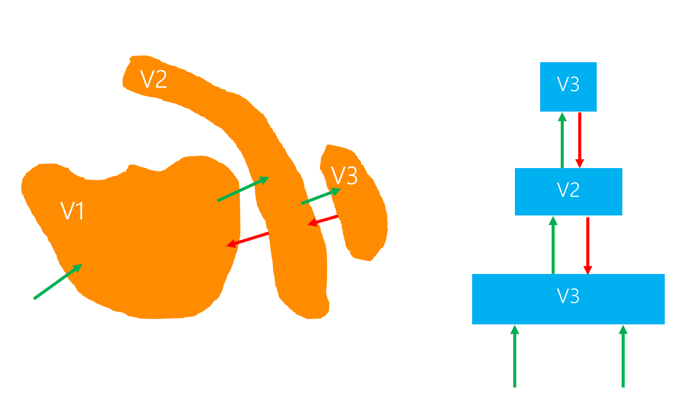
Hierarchical Semantic Layers

Slide 17
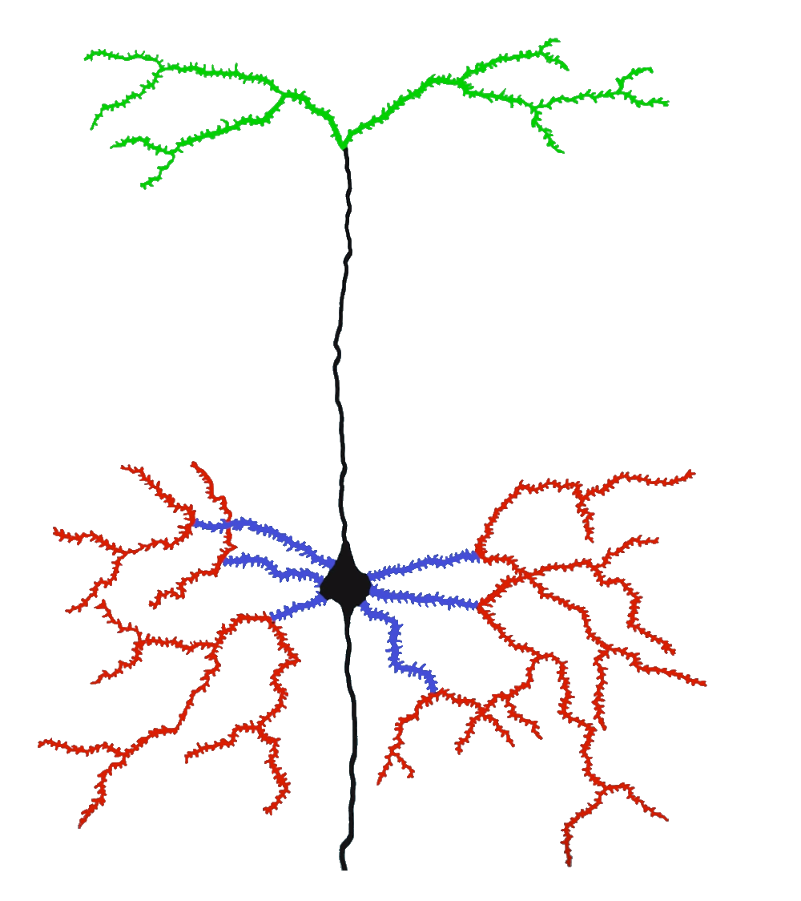
Hierarchical Temporal Memory Cortical Algorithm
Inspired by Neocortex
Different model of artifficial neuron
Dynamic Synapse grow
Inhibition
Boosting (homeostatic elasticity)
Two algorithms
Spatial Pooler
Temporal Memory
Feedback (apical)
Context (distal)
Feedforward (proximal)

Slide 18
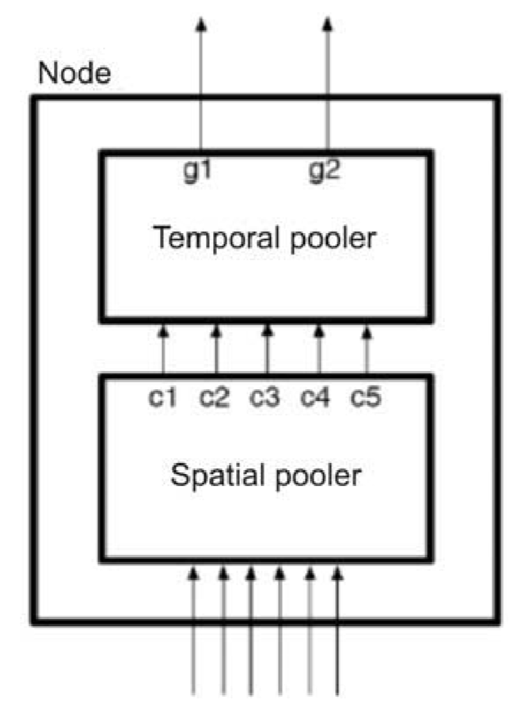
HTM CLA two algorithms
Spatial Pooler
Temporal Memory (new, Temporal Pooler is the old name)
Encoder

Slide 19
ENCODER

Slide 20
What is an encoder?
HTM systems require data input in the form of Sparse Distributed Representations (SDRs)
SDR = Sparse Date Representation
An SDR is a large array of bits of which most are zeros and a few are ones.
First step of using an HTM system is to convert a data source into an SDR
https://pdfs.semanticscholar.org/1455/2052a0ee729539298e4f8eb42292c0eb1622.pdf

Slide 21
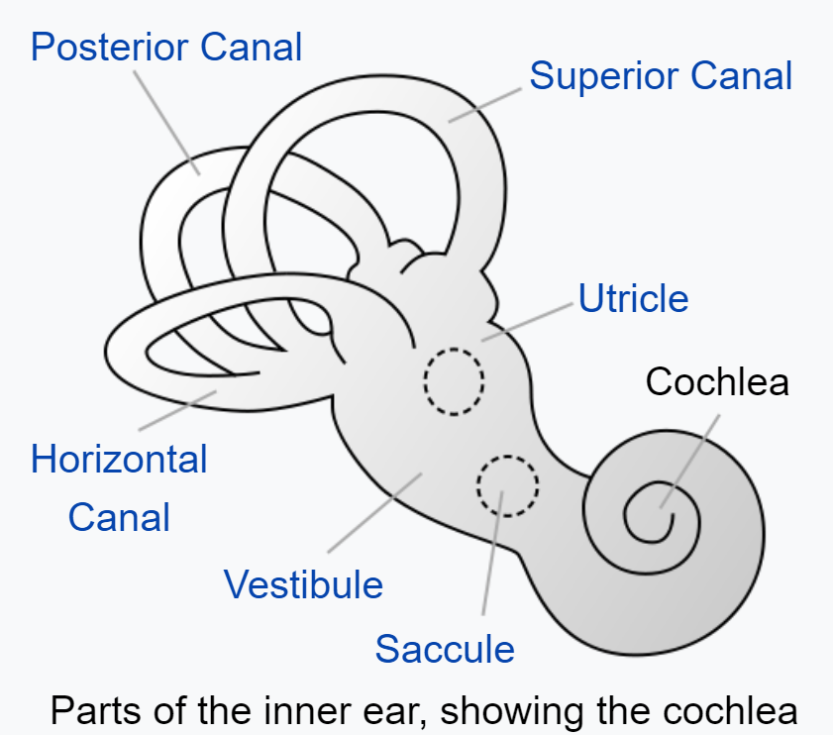
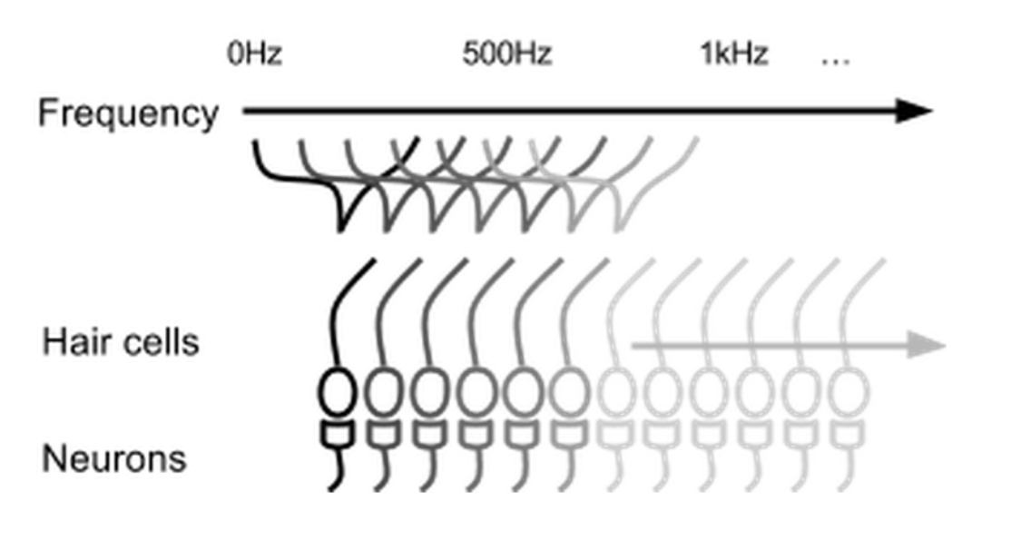

Parts of inner ear - Cochlea
Cochlear hair cells stimulate a set of neurons based on the frequency of the sound.

Slide 22
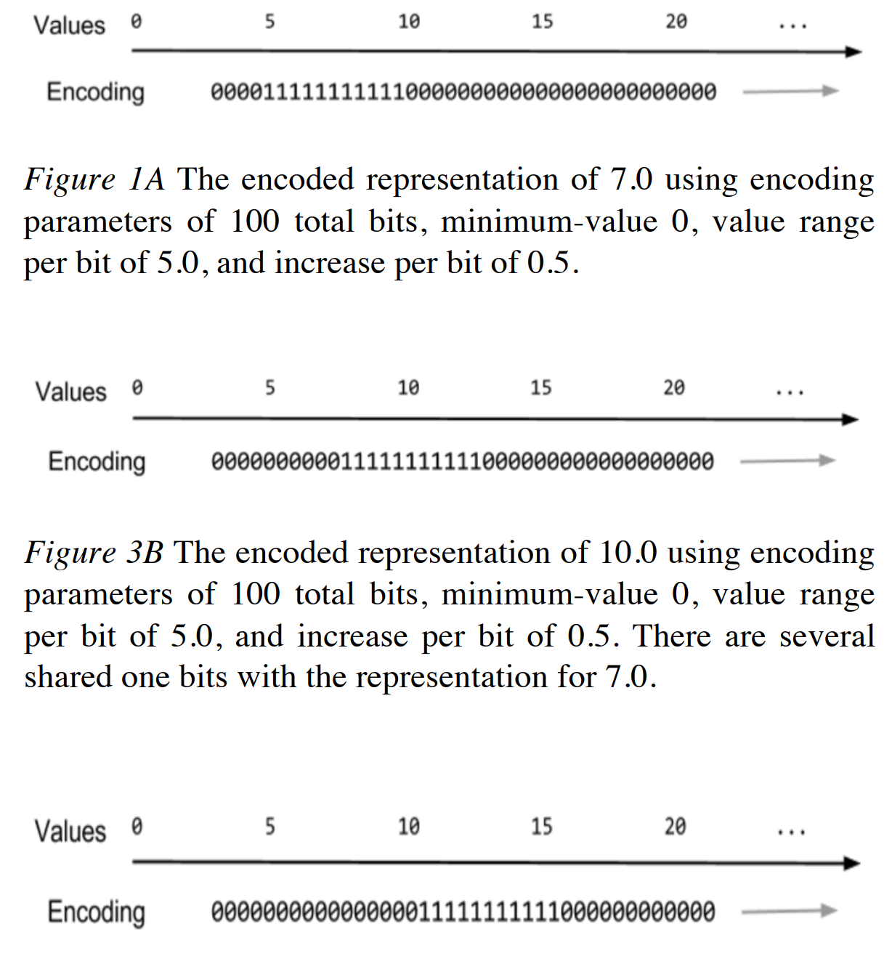
Encoding of scalar values

Slide 23
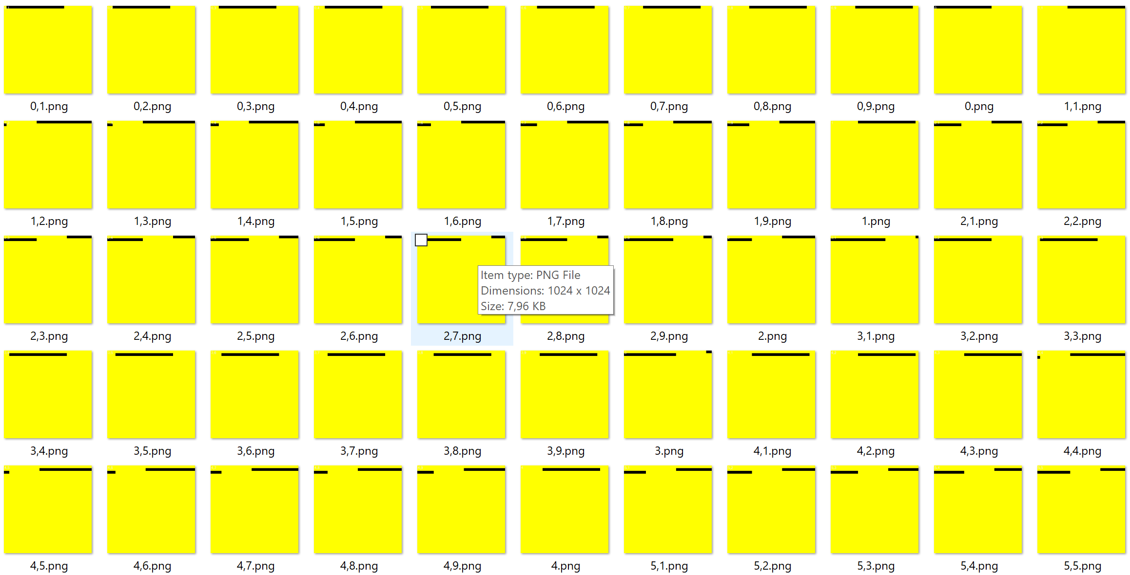
Example: Encoding of scalar values

Slide 24
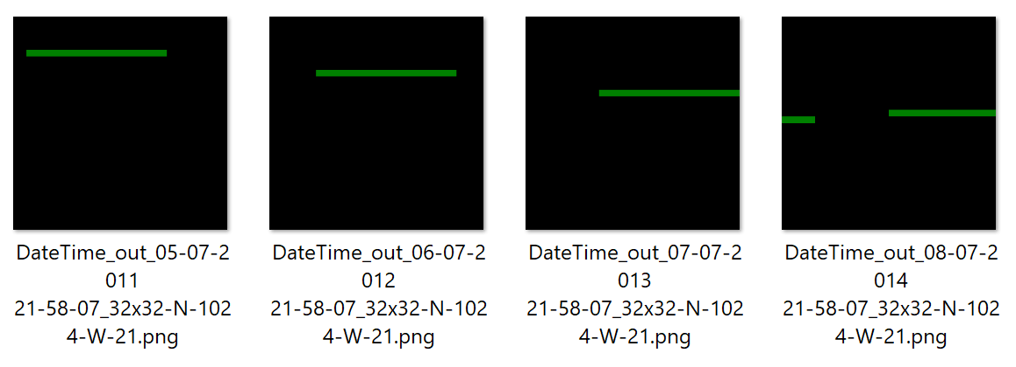
DateTime encoder

Slide 25

Definitions

Slide 26

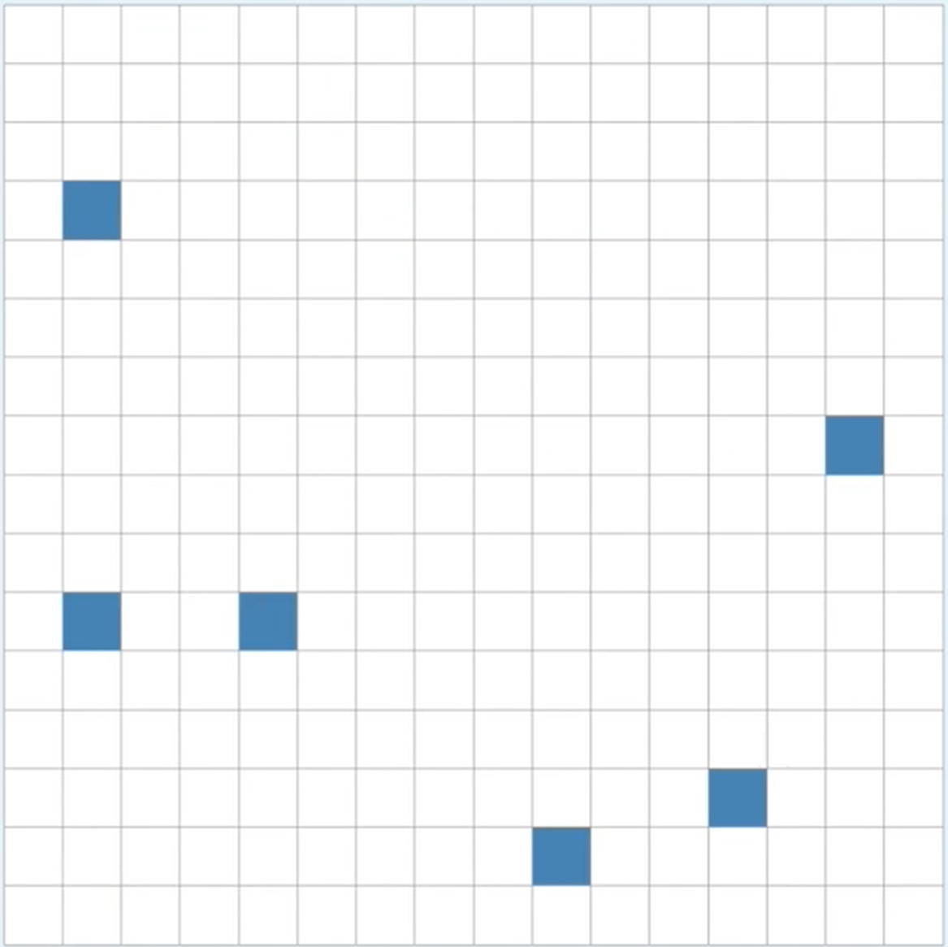
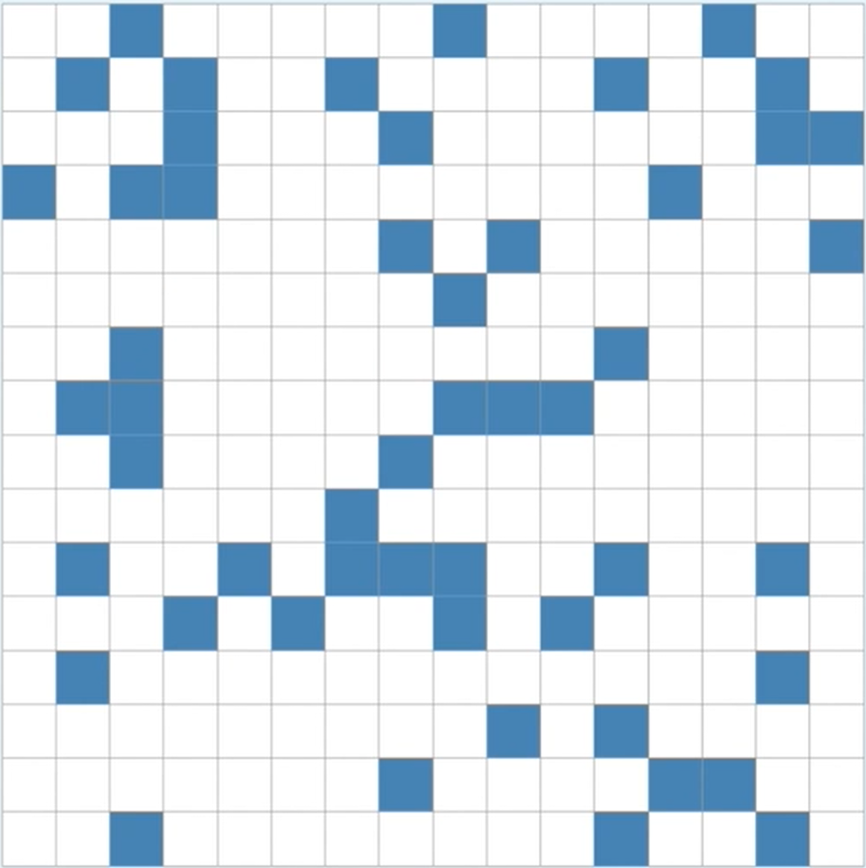
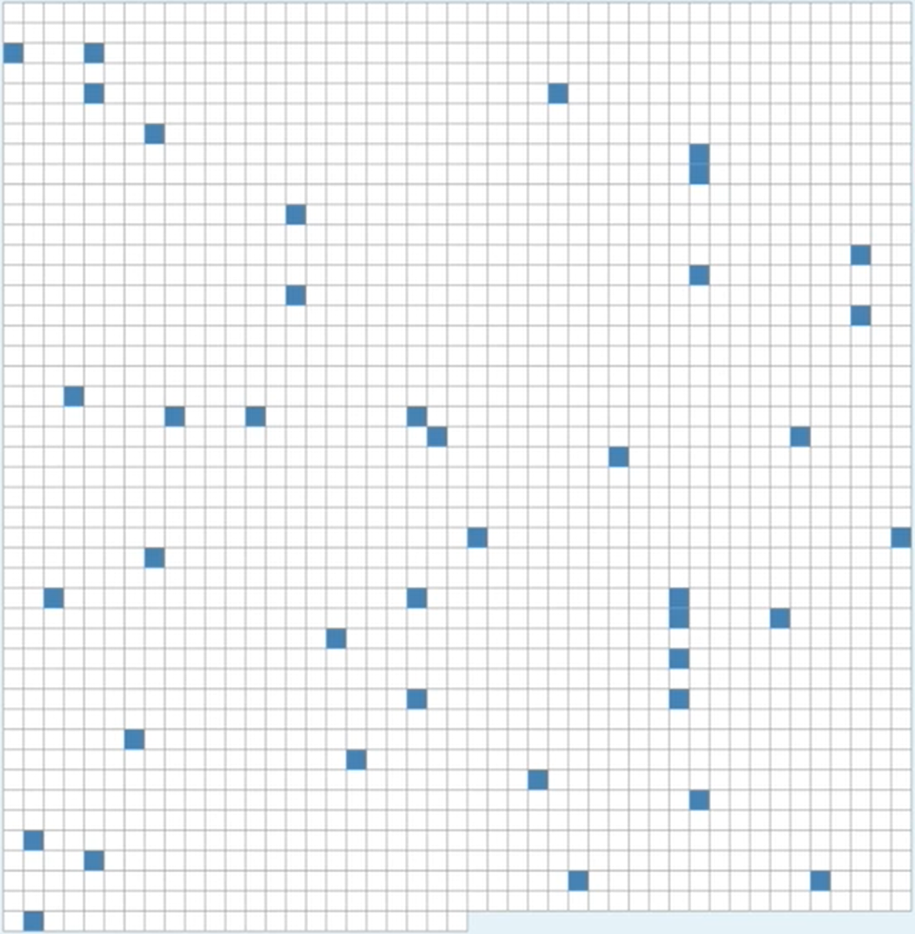
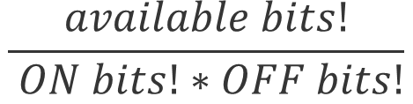
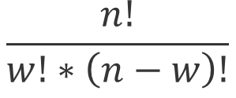
Capacity and Density
n = 16 w = 0 d = 0 c = 1
n = 16 w = 1 d =0.625 c = 16
n = 16 w = 2 d =0.125 c = 120
n = 256 w = 6 d =0.0234 c =368532892176
n = 256 w = 51 d =0.192 c ~ 2034388346E45
n = 2048 w = 40 d =0.0195 c ~ 2371E81
$$\frac{available bits!}{ ON bits!∗OFF bits!}$$
$$\frac{n!}{w!∗\left(n−w\right)!}$$

Slide 27
Using encoder
ScalarEncoder encoder = new ScalarEncoder(new Dictionary<string, object>()
{
{ "W", 21},
{ "N", 1024},
{ "Radius", -1.0},
{ "MinVal", 0.0},
{ "MaxVal", 100.0 },
{ "Periodic", false},
{ "Name", "scalar"},
{ "ClipInput", false},
});
var result = encoder.Encode(i);
int[,] twoDimenArray = ArrayUtils.Make2DArray<int>(result, (int)Math.Sqrt(result.Length), (int)Math.Sqrt(result.Length));
var twoDimArray = ArrayUtils.Transpose(twoDimenArray);
NeoCortexUtils.DrawBitmap(twoDimArray, 1024, 1024, $"{outFolder}\\{i}.png", Color.Yellow, Color.Black, text:i.ToString());

Slide 28
SPATIAL POOLER

Slide 29
What is the Spatial Pooler?
It creates the SDR code of the given input

Slide 30


MNIST image of digits
SDR code of ‘5’
input
SDR code of ‘3’
input

Slide 31
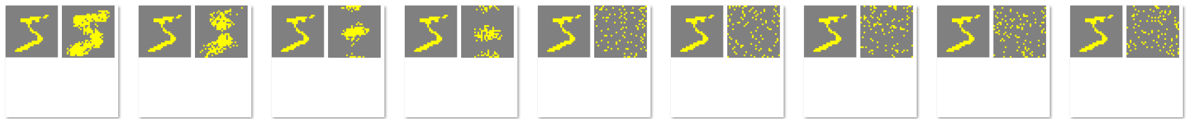
Inhibition Radius
10%
90%

Slide 32
Using SpatialPooler
public void SpatialSequenceLearningExperiment()
{
var parameters = GetDefaultParams();
parameters.Set(KEY.POTENTIAL_RADIUS, 64 * 64);
parameters.Set(KEY.POTENTIAL_PCT, 1.0);
parameters.Set(KEY.GLOBAL_INHIBITION, false);
parameters.Set(KEY.STIMULUS_THRESHOLD, 0.5);
parameters.Set(KEY.INHIBITION_RADIUS, (int)0.25 * 64 * 64);
parameters.Set(KEY.LOCAL_AREA_DENSITY, -1);
parameters.Set(KEY.NUM_ACTIVE_COLUMNS_PER_INH_AREA, 0.1 * 64 * 64);
parameters.Set(KEY.DUTY_CYCLE_PERIOD, 1000000);
parameters.Set(KEY.MAX_BOOST, 5);
parameters.setInputDimensions(new int[] { 32, 32 });
parameters.setColumnDimensions(new int[] { 64, 64 });
parameters.setNumActiveColumnsPerInhArea(0.02 * 64 * 64);
var sp = new SpatialPooler();
var mem = new Connections();
double[] inputSequence = new double[] { 1.0, 2.0, 3.0, 4.0, 5.0, 6.0, 7.0 };
var inputVectors = GetEncodedSequence(inputSequence, 0.0, 100.0);
parameters.apply(mem);
sp.init(mem);
. . .
}

Slide 33
Using SpatialPooler
public void SpatialSequenceLearningExperiment()
{
. . .
parameters.apply(mem);
sp.init(mem);
foreach (var inputVector in inputVectors)
{
for (int i = 0; i < 3; i++)
{
var activeArray = sp.Compute(inputVector, true) as int[];
var activeCols = ArrayUtils.IndexWhere(activeArray, (el) => el == 1);
var str = Helpers.StringifyVector(activeCols);
Debug.WriteLine(str);
}
}
}

Slide 34
SpatialPooler Compute() nethod
var activeIndicies = sp.Compute(inputVector, true, true) as int[];
var activeArray = sp.Compute(inputVector, true, false) as int[];
Debug.WriteLine(Helpers.StringifyVector(activeArray));
Debug.WriteLine(Helpers.StringifyVector(activeIndicies));
2,3,..
0,0,1,1,0,0..

Slide 35
Examples for Spatial Pooler
All tests are implemented in project: UnitTestsProject
SP Tests:
Experiments: SpatialPoolerResearchTests
UnitTests: SpatialPoolerTests

Slide 36
TEMPORAL MEMORY

Slide 37
Examples for Temporal Memory
All tests are implemented in project: UnitTestsProject
Temporal Memory Tests:
Experiments: NetworkTests.cs
UnitTests: TemporalMemoryTests.cs

Slide 38
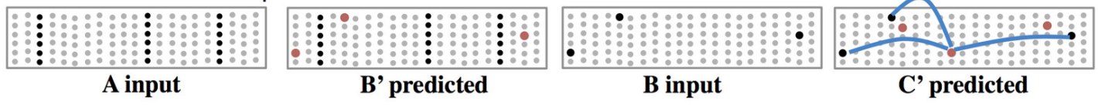
Layers Model & Sequence Memory

Slide 39
References
https://www.youtube.com/watch?v=Ub1fE-bAroA
https://en.wikipedia.org/wiki/Hierarchical_temporal_memory
https://www.youtube.com/watch?v=nBYddmFg4nQ
https://web.archive.org/web/20110714212402/http://www.numenta.com/htm-overview/education.php

Slide 40

Thank You

Slide 41
MATH C#
---------------------------------------------------------------
x1 = {1.2, 2.8, 3.5} | var x1 = new double[] {1.2, 2.8, 3.5}
x2 = {1.2, 2.5, 2.9} | var x1 = new double[] {1.2, 2.5, 2.9}
xN
----------------------------------------------------------------
double[][] inputVectors = new double[N][];
inputVectors[0] = x1;
inputVectors[1] = x2;
...
inputVectors[N] = xN;
--- Another way ------------
List<double[]> inputVectors = List<double[]>();
inputVectors.Add(x1);
inputVectors.Add(x2);
..
inputVectors.Add(xN);

